Slide 1

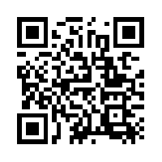
Quantum Communications Group
KML - key synchronization
Group Coordinator:
Armando Nolasco Pinto
anp@ua.pt
Group Websites:
Diogo Matos
https://www.it.pt/Groups/Index/72
LinkedIn: https://www.linkedin.com/company/quantum-communications-group-it-av/

Slide 2
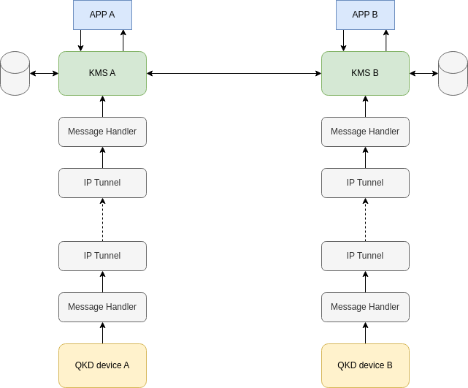
Architecture
Each QKD device generates matching keys, but don’t insure synchronization
Each KMS receives keys and stores them in a database. It’s in this layer that synchronization mechanisms are employed
For a KMS to claim that a specific key synced, is equivalent to know that all peer KMSs have received that key too

Slide 3
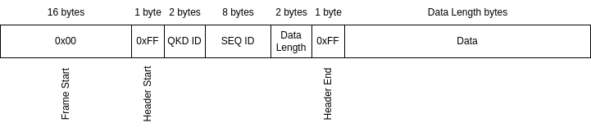
QKD frame
Data sent from the QKD device to the KMS

Slide 4
Key sync message
In order to insure key sync, each KMS sends to its peers a ‘key_sync’ message, notifying them of the keys received since the last message. That’s done by enumerating the seq of the QKD frames.
This message is send on a given period of number of received QKD frames. This period should be customizable for each KMS. For example, a KMS bound to a high key rate can have a higher period than other KMS with a lower key rate.
example:
{‘header’:{
‘srcId’: ‘kms-xpto’,
‘type’: ‘key_sync’,
‘seq’: 2
},
‘data’:{
‘received_seqs’: [4,5,6,7]
}
}

Slide 5
Key storage - fields
ID(PK) | QKD_ID(PK) | SYNC | LC_status | KSID | KS_INDEX | TIMESTAMP | KEY
key identifier seq + index | id of the QKD device that generated the key | peer key sync bit | key life-cycle status | id of the key stream where this key was used | index of the key in the key stream | date and hour of when the key was stored | key material
*not final, more fields will be added in the future

Slide 6
Key storage
Each time a new QKD_frame is received by a KMS an action will be performed based on the following criteria:
current seq was mentioned in a key_sync message sent by each peer KMS:
action: store keys with sync field at 1 (true)
current seq was not mentioned by at least one of the peer KMS’s key_sync messages, but in at least one of them the last notified seq is higher than the current seq:
action: discard keys
default:
action: store keys with sync field at 0 (false)
The seq field might updated based on the received key_sync messages. Unsynced keys are discarded after a given time period.

